Slide 1
Suspicious Activity Detection in Hospital
Team Members:
1.Mayur Kharmate
2. Aniket Uttekar
3. Kunal Desai
4. Shreyas Kulkarni
Guided by:
Deepali Dagale

Slide 2
Agenda
1.Aim
2.Proposed System
3.Implementation Execution
4.Performance Evaluation
5.Comparision with previous/existing systems
6.Validation and Testing
7.Publication Status
8.Project Report
9.Conclusion
10.References

Slide 3
Aim
To Enhance Security in the hospital by detecting suspicious activities and also alert & report authorized personnel about the same.

Slide 4
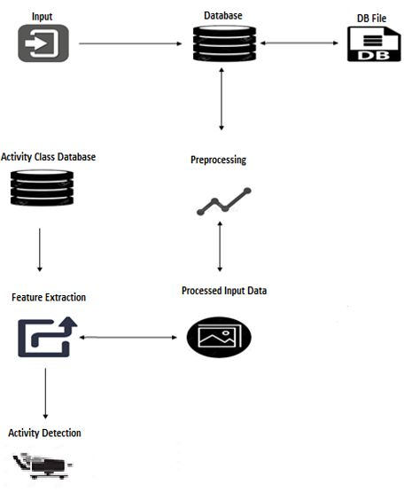
Proposed System
Fig. 1 : flow of activity recognition

Slide 5
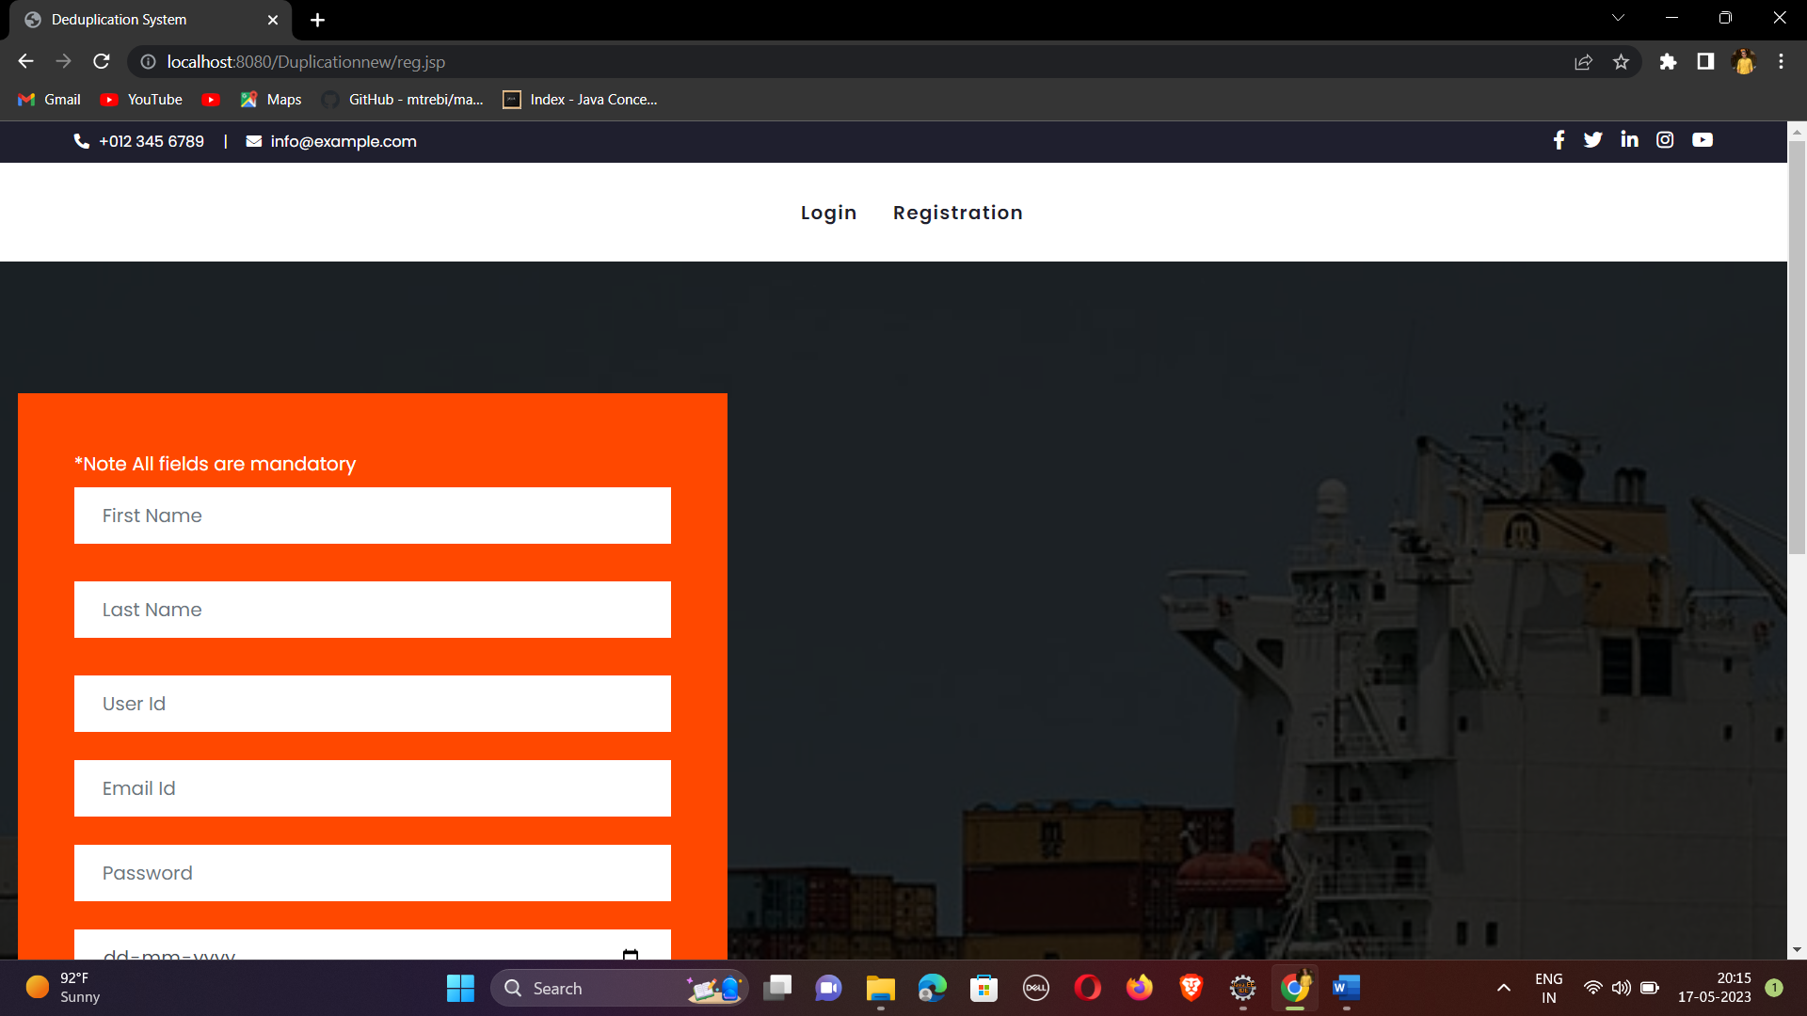
Implementation Execution
Img 1 : User Registration page

Slide 6
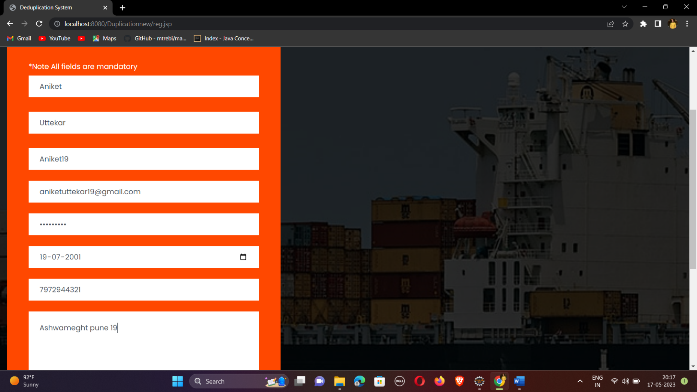

Slide 7
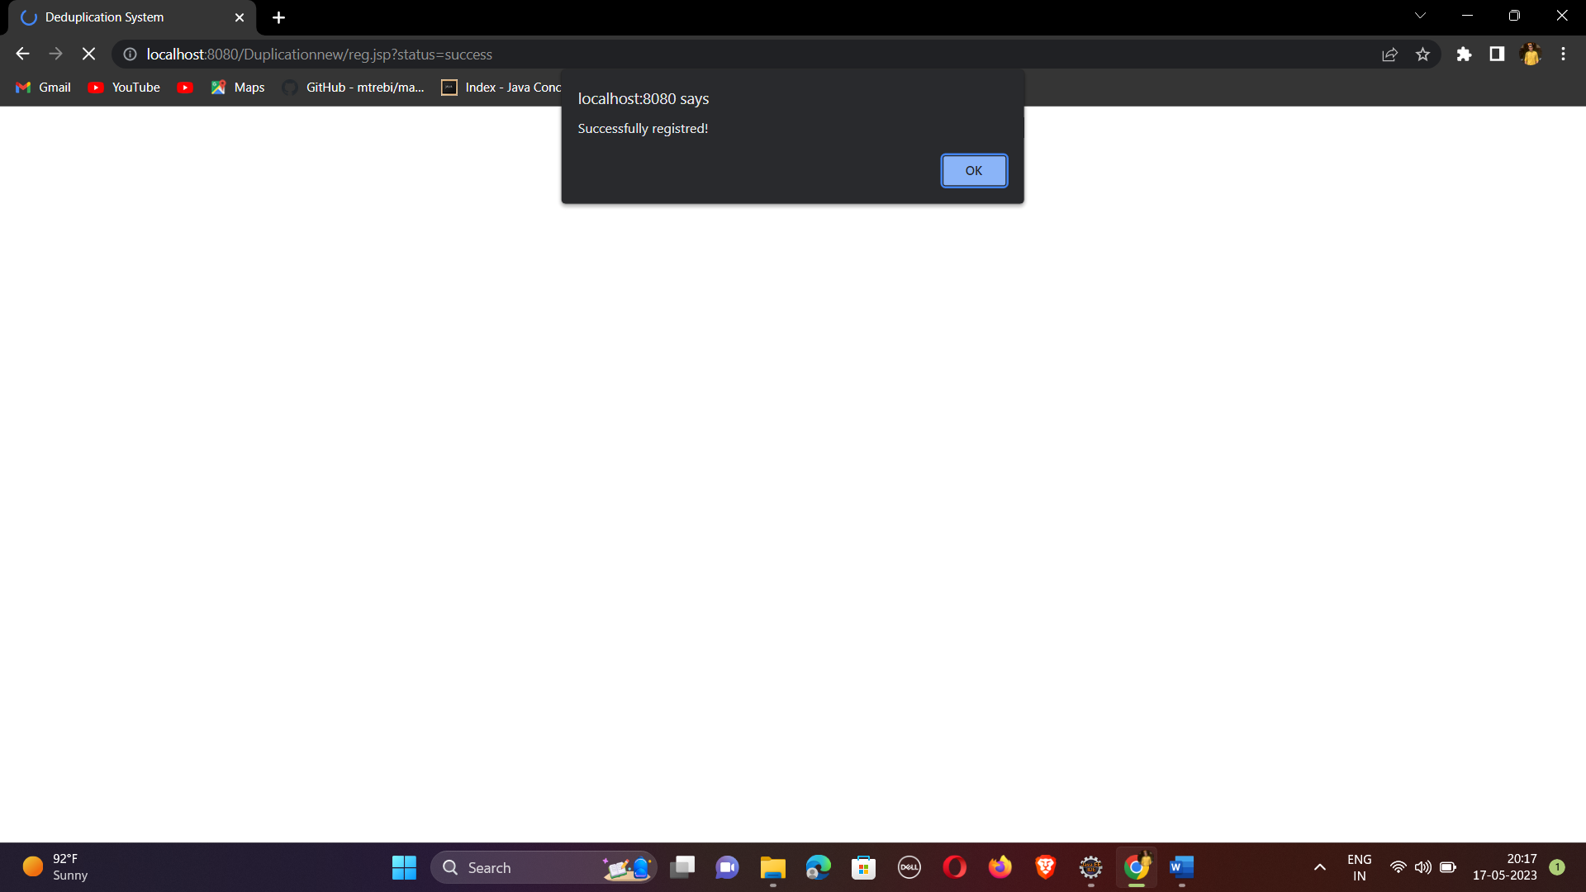

Slide 8
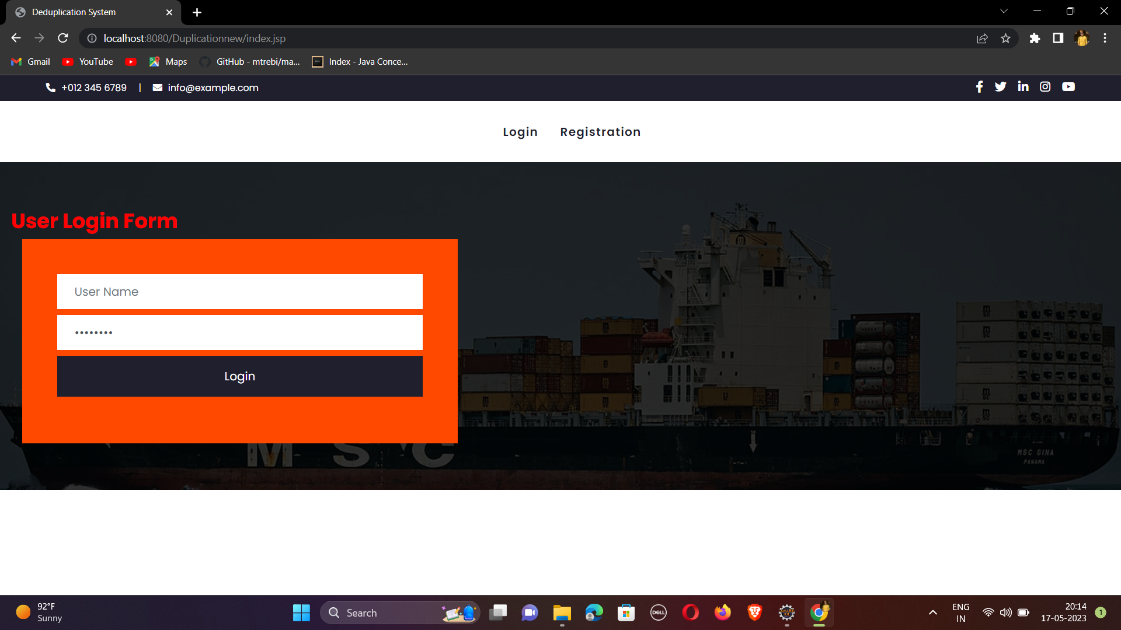
Img 2.A : User Login page

Slide 9
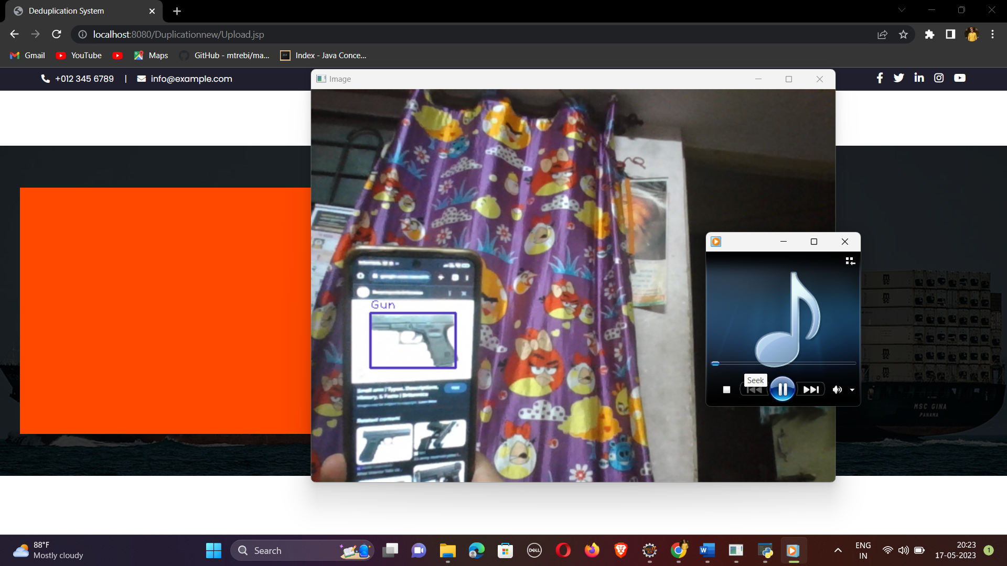

Slide 10
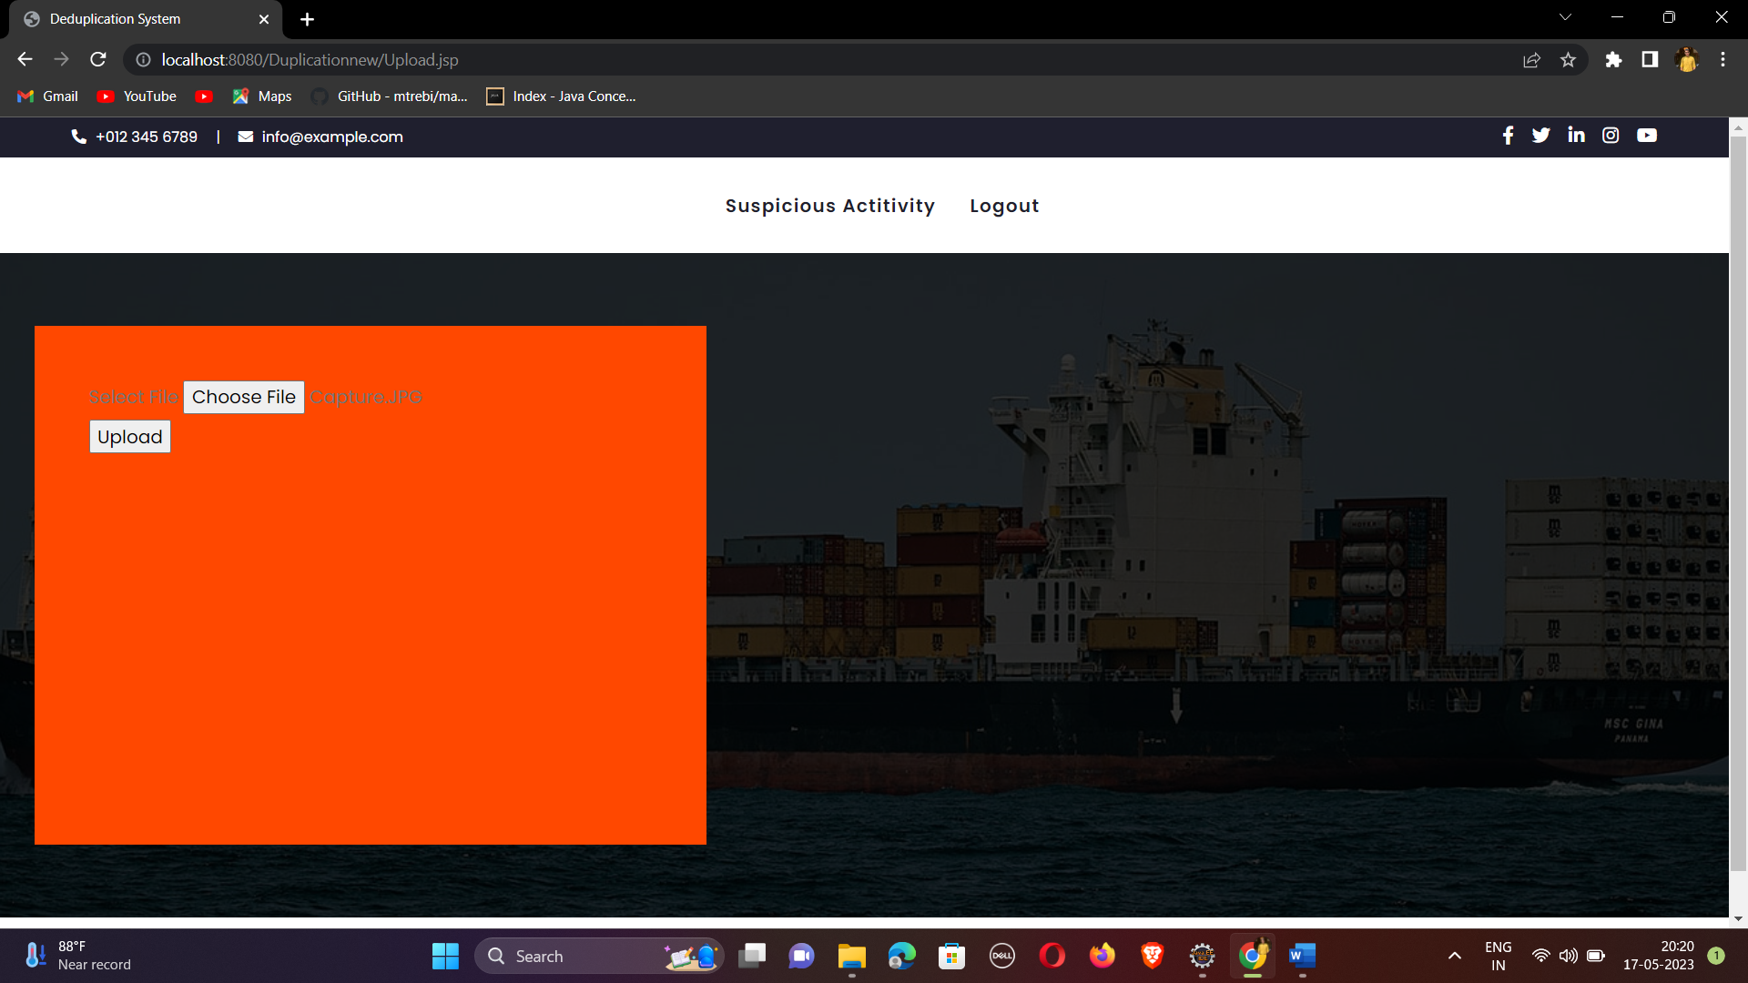

Slide 11


Slide 12
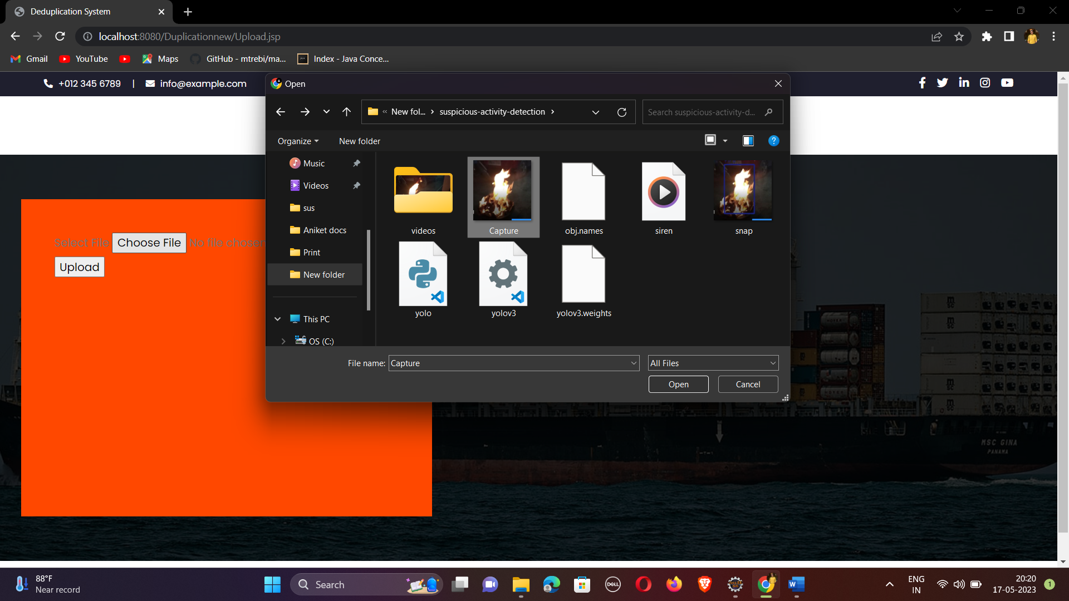

Slide 13
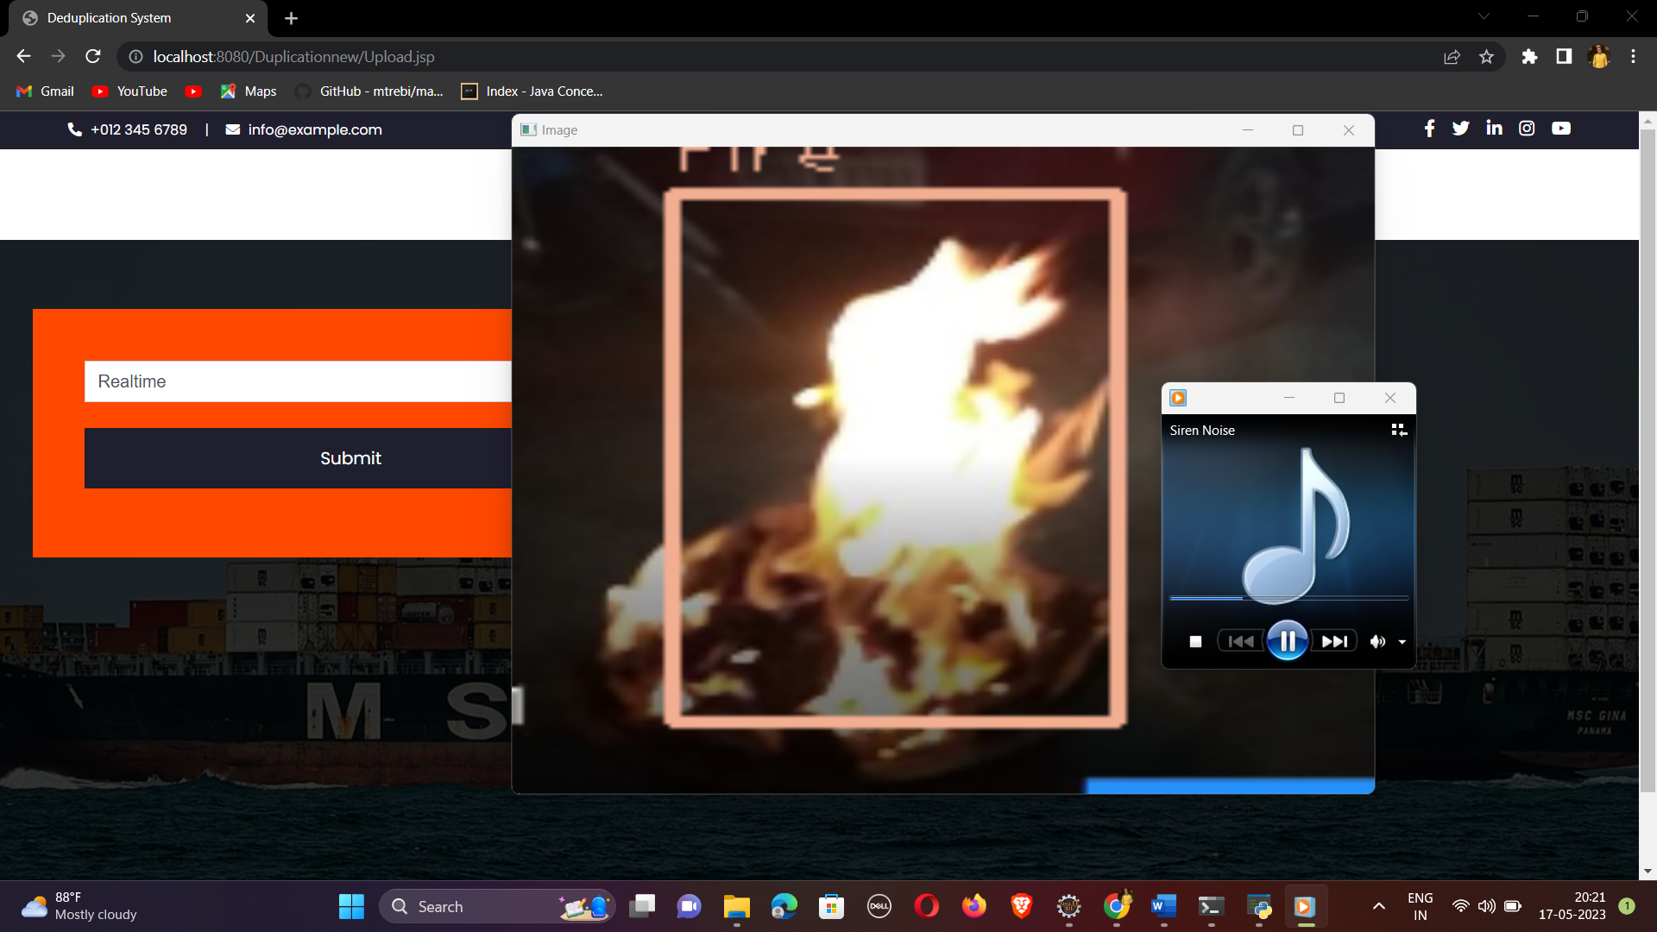

Slide 14
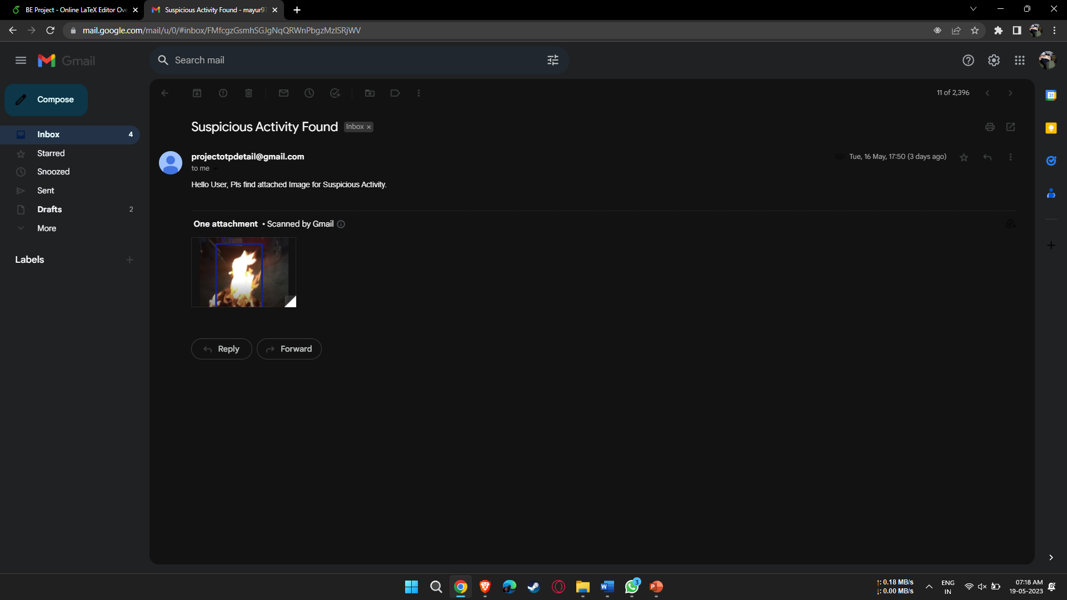

Slide 15
Performance Evaluation
VGG-16 :
Accuracy = 78.76 %
Recall = 90.32 %
F1_Score = 91.46 %
YOLO :
Accuracy = 83.34 %
Recall = 96.32%
F1_Score = 93.26 %

Slide 16
Comparison with existing
There are several existing systems for suspicious activity detection in hospitals, and their performance varies depending on the type of system, data used, and evaluation metrics we have compared it with YOLO algorithm.
Suspicious Activity detection using YOLO tends to be more accurate as compared to other activity detection Systems which mostly run using VGG-16 algorithm .
While working with the large input video Suspicious Activity detection using YOLO is more time and cost effective than the systems with VGG-16 algorithm .
The reason most of the Systems use VGG-16 is because its less complex to model as compared to one with YOLO algorithm ..

Slide 17
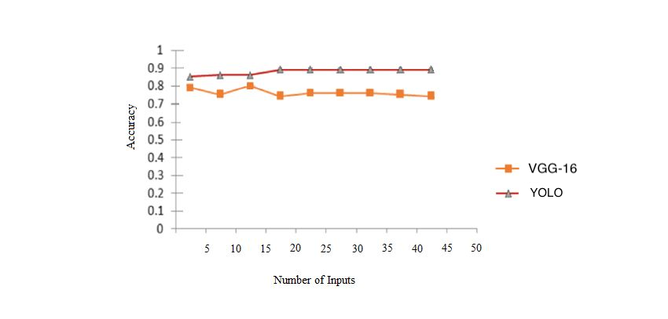
Fig 2 : Comparison of Accuracy between YOLO and VGG-16 algorithm used system

Slide 18
Validation and Testing
Verified whether the user is not able to login using login credentials .
Verified whether the user is not able to registerwith the existing email or phone number .
Verified whether the login details of one user are not accessible to other user
Verified that data that is visible to user is completely depends upon the user logged in.
Verified whether the JSP pages used changes its content as per user interactions.
Verified that after clicking logout, user session is cleared and user is not able to use project again without login.
Verified whether the system can accurately detect and classify suspicious activities.
Verified system's ability to minimize false positive detections.
Verified the integration between project and underlying platform.

Slide 19
Publication Status
We have decided to publish the paper of the project in ICTACT Journal,
under University Grants Commission (UGC) care. The paper has been
submitted to ICTACT. The approval is still pending.

Slide 20
Project Report

Slide 21
Conclusion
In the mentioned project, we have put forward a video analysis model for suspicious activity detection.
This tool is designed to reduce the demanding task of manually sorting through hours of surveillance video sequentially to work out if suspicious activity has occurred .
This project could help the authorities of hospital surveillances to detect suspicious activities like smoking cigarette or unauthorized entry in patient's room.
Automation of such a task could be a huge savior of your time and may speed up the work of the authority’s manyfold .Thus , increasing the Security of the Hospital

Slide 22
References
[1] S. Loganathan, G. Kariyawasam and P. Sumathipala, "Suspicious Activity Detection in Surveillance Footage," 2019 International Conference on Electrical and Computing Technologies and Applications (ICECTA), 2019 [2] Dimitropolus K, Barmpoutis P, Grammalidis N., “Trans Circuit System Video Techno- logy”Proposed a method for real time fire detection to model behavior of fire by using spatio-temporal features like color probability,spatiotemporal energy, pp. 28-40 July 2015
[3] Tripathi V, Gangodkar D, Latta V, Mittal A, “Robust abnormal event recognition via motion and shape analysis at ATM installations”For reducing dimensions PCA was used and for classification SVM was used, pp. 20-34 June 2015 [4] Wiliem A, Madasu V, Boles W, Yarlagadda P, “Computer Vision and Image Understanding”, A suspicious behaviour detection using a context space model for smart surveillance systems, pp. 33-44 March 2012

Slide 23
[5] Joy Iong Zong Chen“Smart Security System for Suspicious Activity Detection in Volatile Areas”, Smart Security, Suspicious Activity, Volatile Areas, Motion Sensors, Facial Identification, pp. 21-33 March 2020
[6] Jie Yin, Qiang Yang, “Sensor-Based Abnormal Human-Activity Detection”, Activity recognition, outlier detection, sensor networks, data mining, pp. 31-42 May 2008
[7] 1P. Rajasekhar Reddy,2B. Nirupa, 3Preetham Kumar, 4S. Vaishnavi, “SUSPICIOUS ACTIVITIES DETECTION USING VIDEO ANALYSIS”, Security, automate, machine learning, deep learning, pp. 19-25 May 2021
[8] Rajesh Kumar, “Suspicious human activity recognition: a review”, Abandoned object ·Theft detection ·Fall detection ·Accidents, pp. 23-34 May 2018

